Slide 1
Lab 3: Using GitHub for Collaboration
Push, Pull, and Branches
Sam Cong
MACS 30122/30222
January 24, 2025

Slide 2
(Hopefully) After This Lab
Outlook of advanced topics
1 Different types of merge
2 Ways to withdraw an action
3 Different workflows
03
Refresh memory on git and github
1 The relationship between git and github
2 Different parts of git repositories
01
02
Understand pros and cons of different ways of collaboration
1 Only Push and Pull
2 Fork and Pull Requests
3 Branch and Merge

Slide 3


Introduction to Git and GitHub
Distributed version control system => Tracking changes, collaborating on code.
Cloud-based platform for hosting Git repositories. => Collaboration, issue tracking, code review.

Slide 4
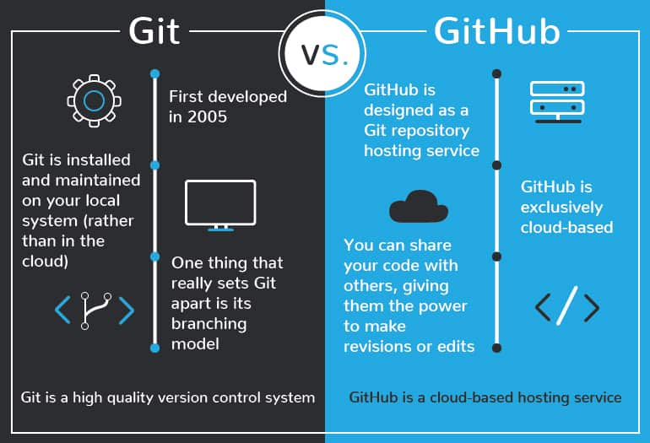
Introduction to Git and GitHub
Image source: https://devmountain.com/blog/git-vs-github-whats-the-difference/

Slide 5
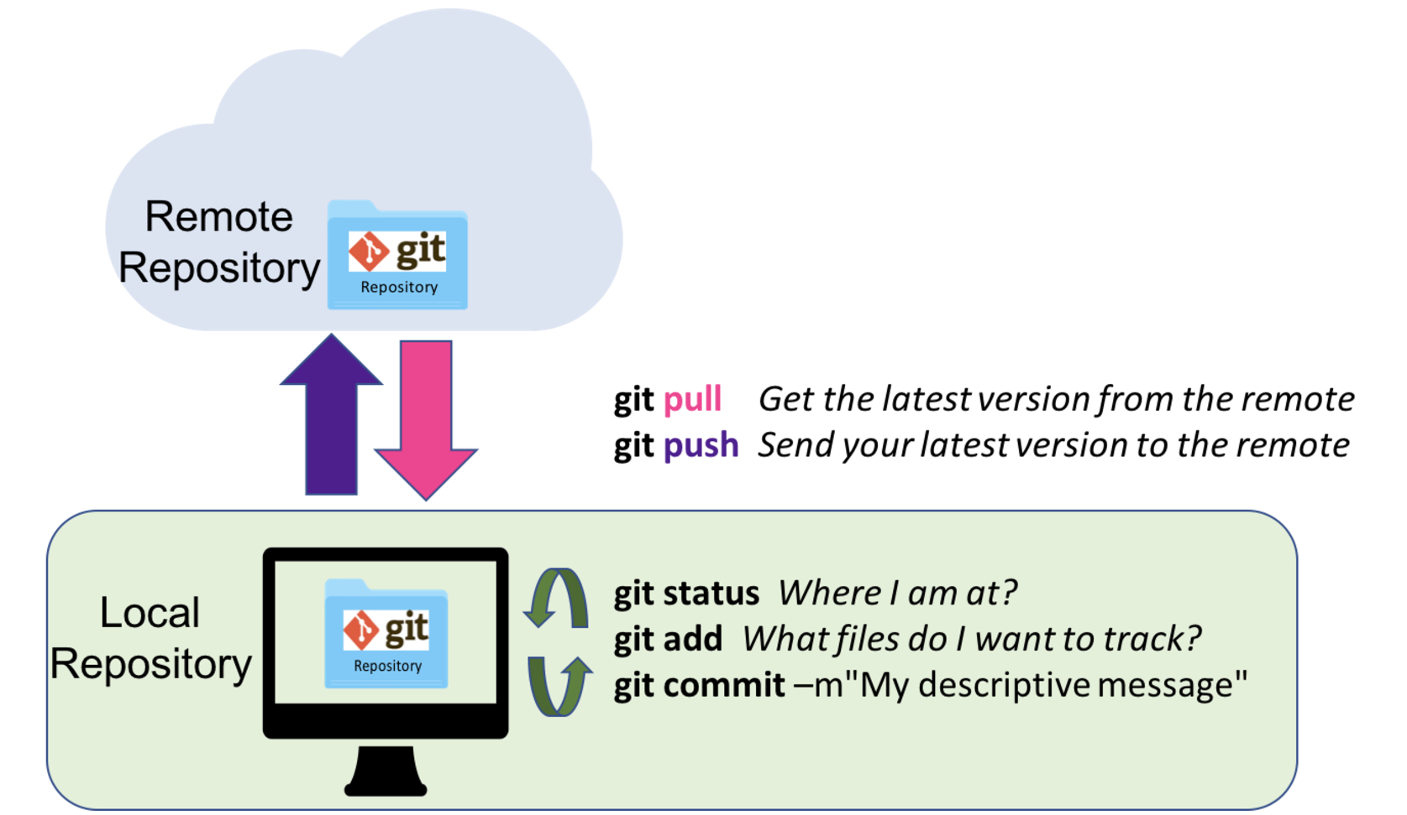
Using GitHub for Individual Projects
Version control to track changes over time.
Backup your work to the cloud.
Maintain a clear history of progress.
Image source: https://nceas.github.io/oss-lessons/version-control/2-git-remote-collaboration.html

Slide 6
Yet, No Man Is an Island 😀

Slide 7
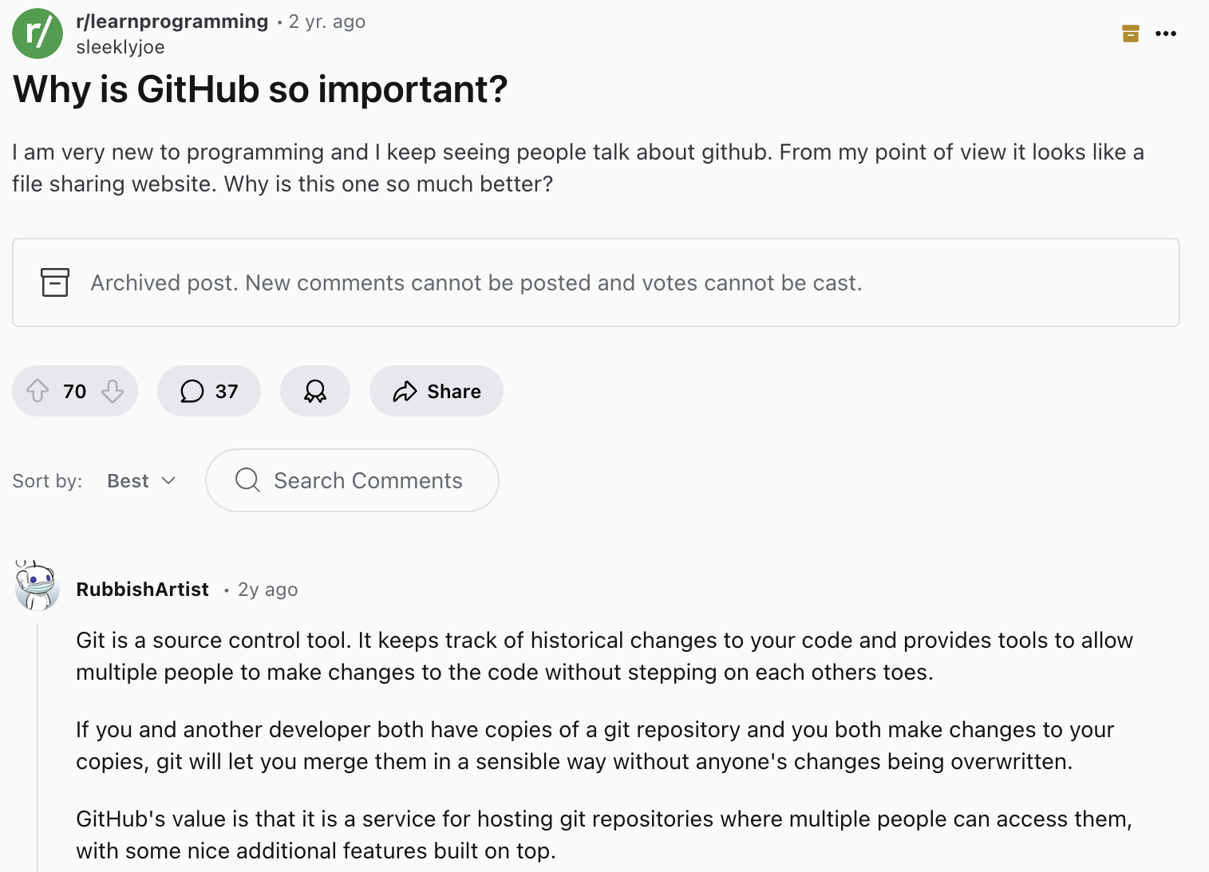
Using GitHub for Collaboration
Centralized version control allows for easy collaboration across developers
Shared Repo
Developer
Developer
Developer
Each computer (local repo) fully mirror (i.e., “clone”) the remote repo, including its whole history
Image source: https://www.reddit.com/r/learnprogramming/comments/wg463w/why_is_github_so_important/

Slide 8
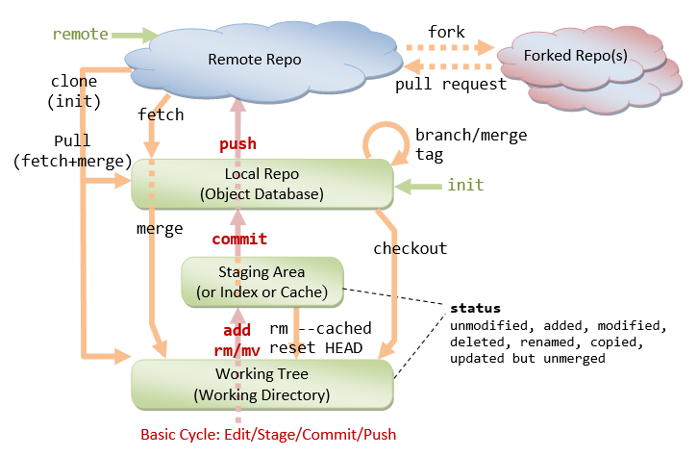
Revisiting Git and Github
Remote, Local, and Forked Repo
Working Tree, Staging Area and Local Repo
Pull versus Fetch
Branch and Checkout
Image source: https://www3.ntu.edu.sg/home/ehchua/programming/howto/Git_HowTo.html

Slide 9
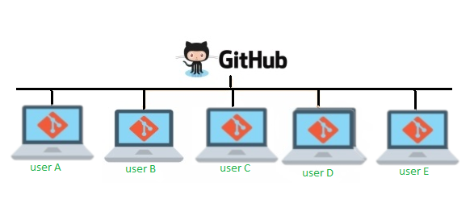
How Do We Collaborate Using Github?
Only Push and Pull (on a Shared Main Branch)
Not recommended ⚠️ (An bad example)
Fork and Pull Requests
Recommended & beginner-friendly 👍
Branch and Merge
Recommended yet sleeper learning curve 🧠
Image source: https://faun.pub/version-control-collaboration-with-git-github-8bcd26193992
Notes:
Probably demonstrate all the three approaches using my demo github repo (resetting to the fresh start using “reset” after each approach).

Slide 10
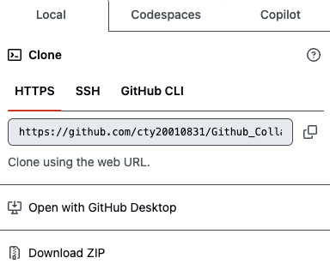
Only Push and Pull
What are the drawbacks?
Team members clone a shared repository, work locally, and push their changes directly to the main branch.
Key Workflow:
Clone the repository (git clone).
Make changes, stage (git add), and commit (git commit).
Push changes (git push).
Image source: https://www3.ntu.edu.sg/home/ehchua/programming/howto/Git_HowTo.html

Slide 11
Only Push and Pull
High Risk of Overwriting Changes (No Isolation)
If multiple people are working on the same files, one person’s push can overwrite another’s changes, leading to lost work or difficult merges.
Suppose Alice and Bob are both working on main.py. Alice starts making changes to the file without pulling the latest updates from the remote repository. Meanwhile, Bob also modifies main.py and pushes his changes first. When Alice finishes her edits and tries to push, Git rejects her push because her local version is outdated. Now, Alice must manually pull the latest changes, resolve any conflicts, and then push again.
Image source: https://www3.ntu.edu.sg/home/ehchua/programming/howto/Git_HowTo.html

Slide 12
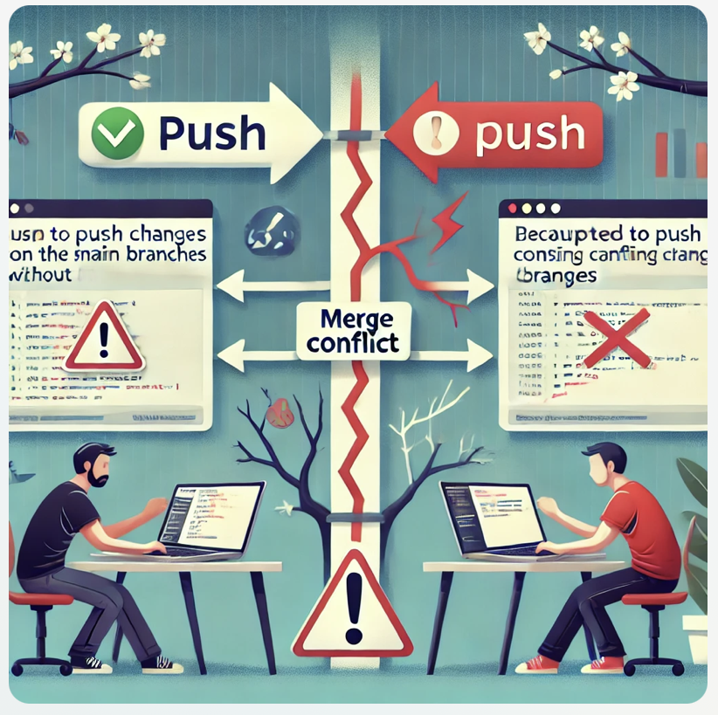
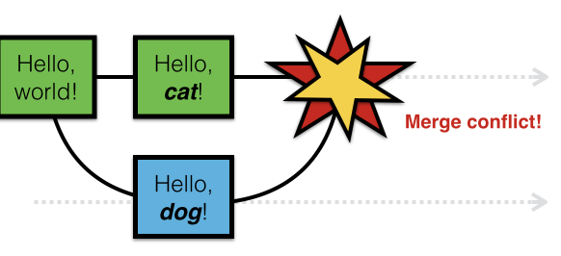
Only Push and Pull
Merge Conflicts Become Frequent and Disruptive
Since all work is done directly on the same branch, conflicts become constant.
Resolving merge conflicts frequently slows down progress and can introduce errors.
Another way to understand it is that it could be difficult to work on multiple features simultaneously. Specifically, If everyone works on main, they need to finish their feature before starting another to avoid mixing code. If a feature takes a long time, it blocks the main branch.
Left image source: https://www.earthdatascience.org/workshops/intro-version-control-git/pull-request/
Right image is generated using ChatGPT.
Notes:
Probably works (?) for small teams where 1) changes are infrequent and well-coordinated and/or 2) parts are relatively independent (less conflicting files).

Slide 13


Only Push and Pull
No Code Review or Testing Before Merging
Since changes go directly into the main codebase, bugs and incomplete features can break the main branch at any time.
Why pull request matters!
Left image source: https://medium.com/codex/code-reviews-21fff62102aa
Right image source: https://iconduck.com/icons/8501/pull-requests
Notes:
A minor demo of conflicts when doing push and pull for an individual project => The idea extends to collaboration (and makes things even worse).

Slide 14
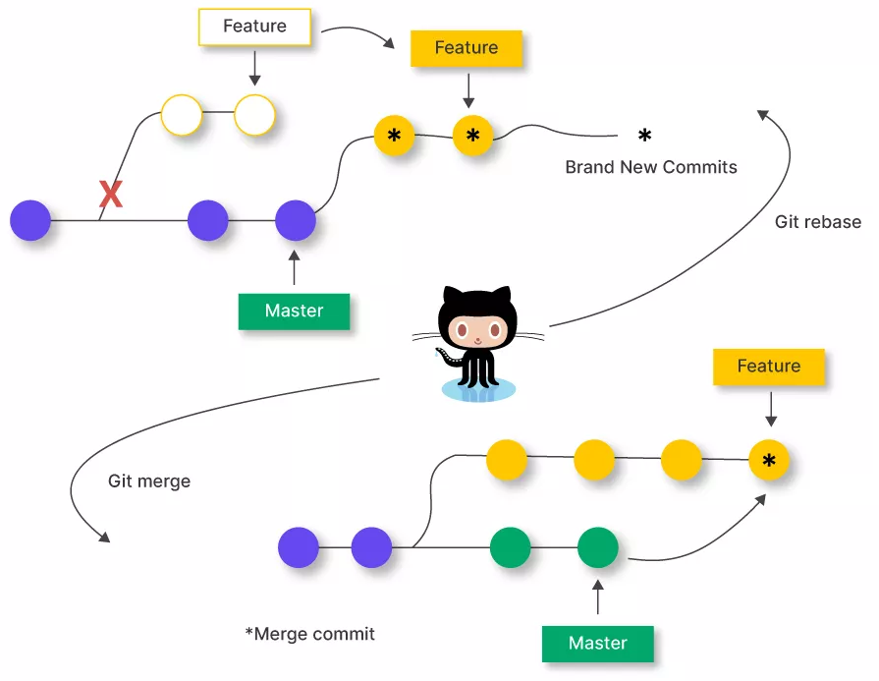
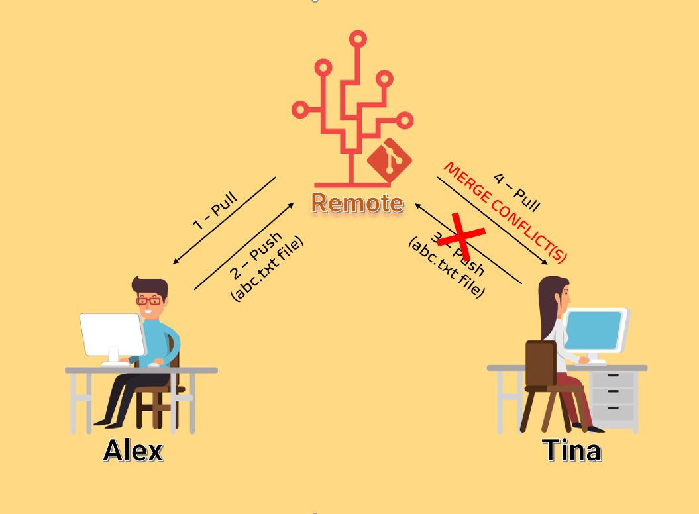
Only Push and Pull
Merge VS Rebase
Demo of potential chaos 😔
(Optional) Feel free to consult online resources for better explanation of the difference between merge and rebase
Left image source: https://www.freecodecamp.org/news/resolve-merge-conflicts-in-git-a-practical-guide/
Right image source: https://unstop.com/blog/git-rebase-vs-merge

Slide 15
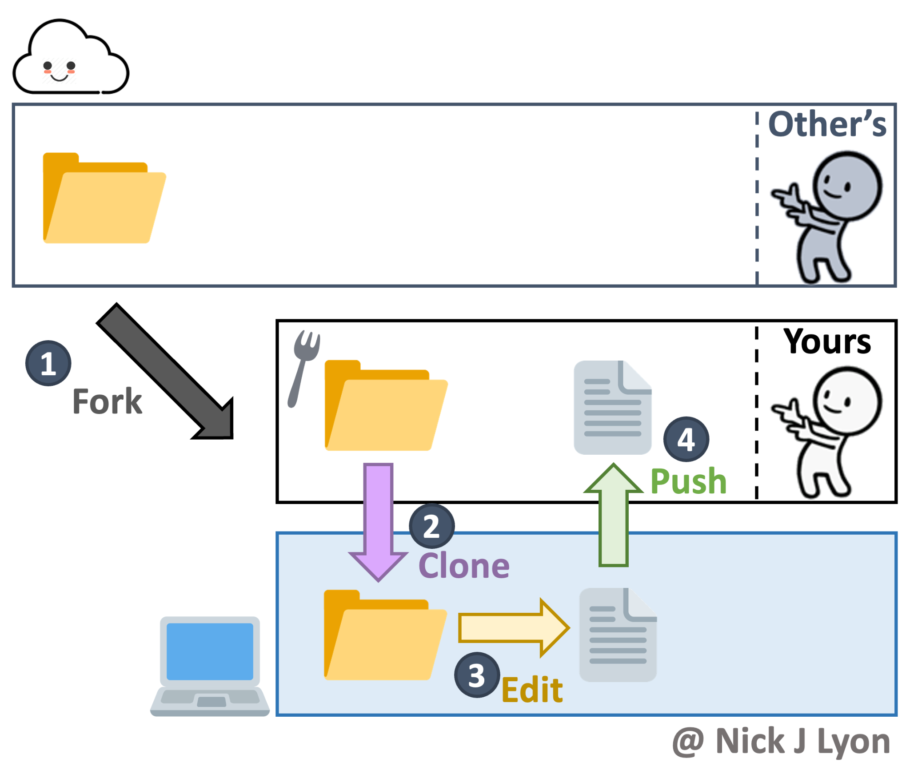

2. Fork and Pull Requests
Pull Request
Left image source: https://dev.to/cadams/why-git-fork-is-my-favorite-git-client-19fe
Right image source: https://pages.github.nceas.ucsb.edu/lter/github-workshop/appendix-c-forks.html#what-is-a-fork

Slide 16

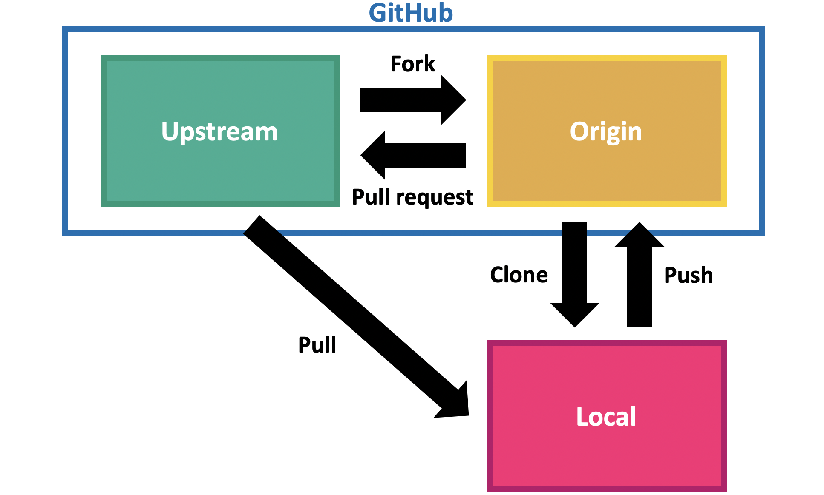
2. Fork and Pull Requests
A fork is a new repository that shares code and visibility settings with the original “upstream” repository. Forks are often used to iterate on ideas or changes before they are proposed back to the upstream repository.
✅ Work independently on a project.
✅ Experiment with changes before merging.
✅ Contribute to open-source projects.
✅ Keep the original project unchanged.
If you want to contribute back to the upstream repository, you can send a request to the original author to pull your fork into their repository by submitting a pull request.
Pull requests communicate changes to a branch in a repository. Once a pull request is opened, you can review changes with collaborators and add follow-up commits.
Reference: https://docs.github.com/en/pull-requests/collaborating-with-pull-requests/working-with-forks/fork-a-repo
Left image source: https://iconduck.com/icons/315749/git-fork
Right image source: https://www.tomasbeuzen.com/post/git-fork-branch-pull/

Slide 17
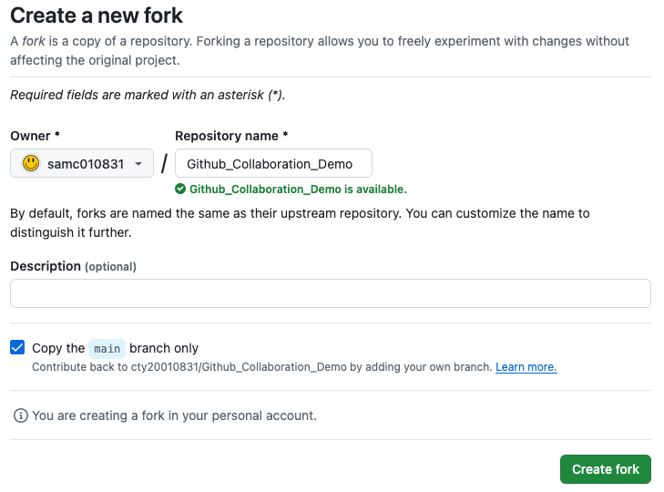
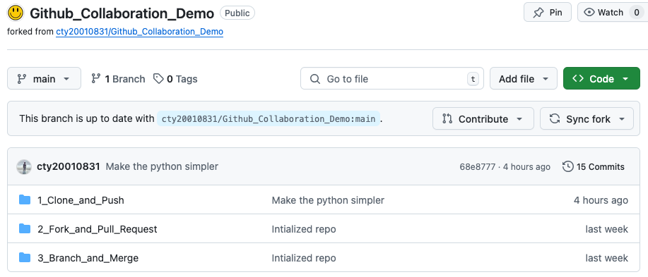
2. Fork and Pull Requests in Action

Slide 18
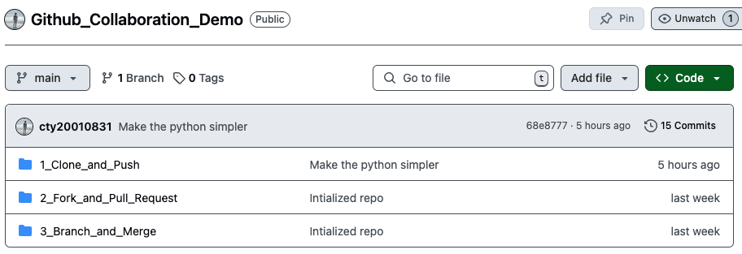
2. Fork and Pull Requests in Action
(Remote) Upstream Repo 🌐
Remote Forked Repo 🌐
Fork
Pull Request
Push
Clone
Local 🖥️

Slide 19
2. Fork and Pull Requests in Action
Best Practice for Setting up Local Forked Repo
# Step 1: Clone Your Fork
git clone https://github.com/[your-username]/[repo-name].git
cd [repo-name]
# Step 2: Add the Original Repository as an Upstream Remote
git remote add upstream https://github.com/[original-owner]/[repo-name].git
# Step 3: Fetch Updates from the Original Repository
git fetch upstream
# Step 4: Merge Updates into Your Fork’s Main Branch
git checkout main # Ensure you're on the main branch
git merge upstream/main

Slide 20

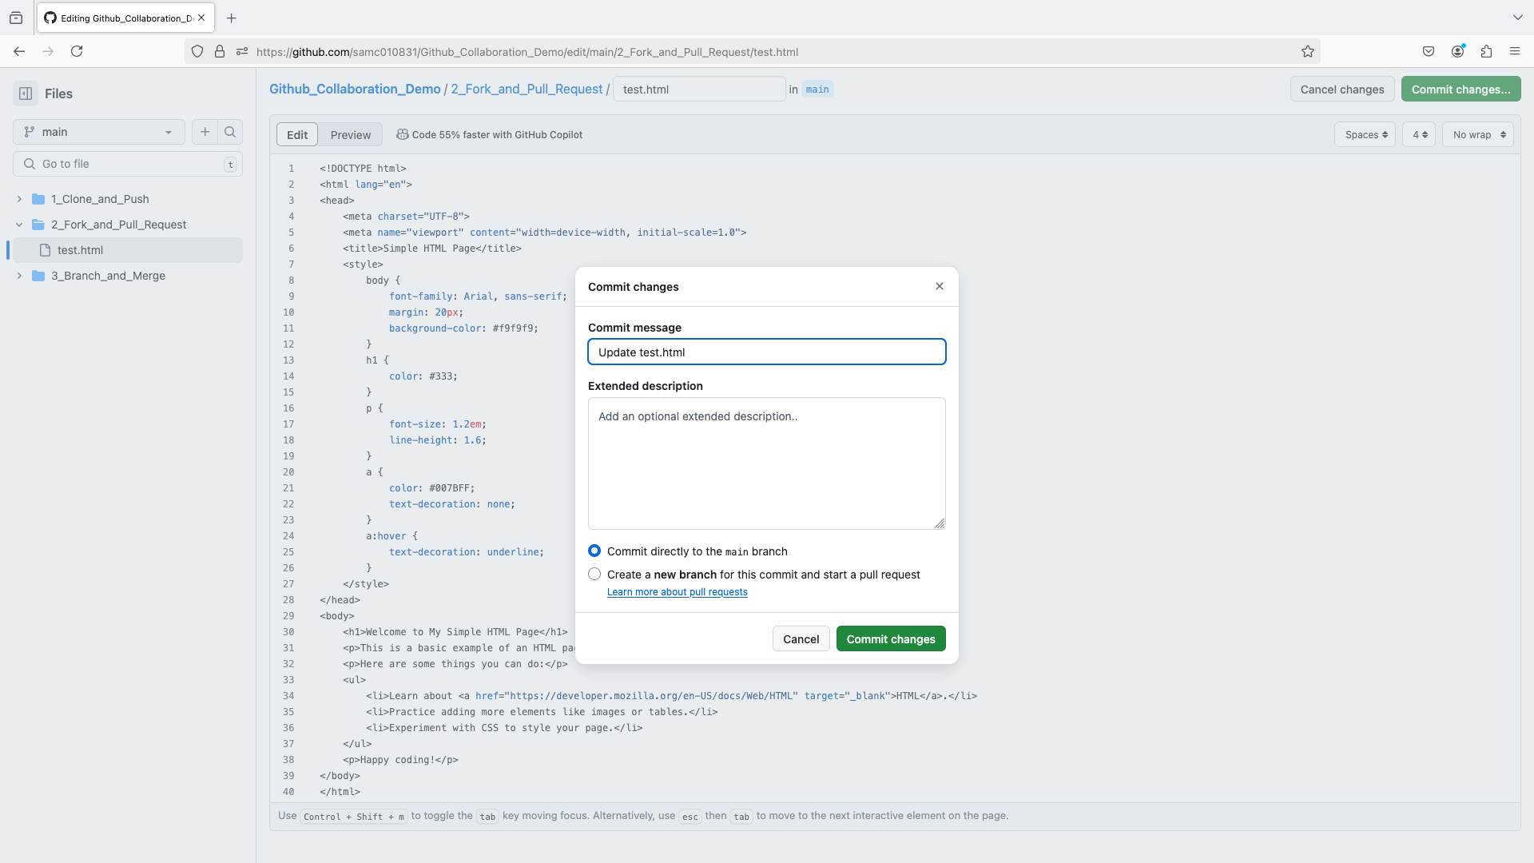
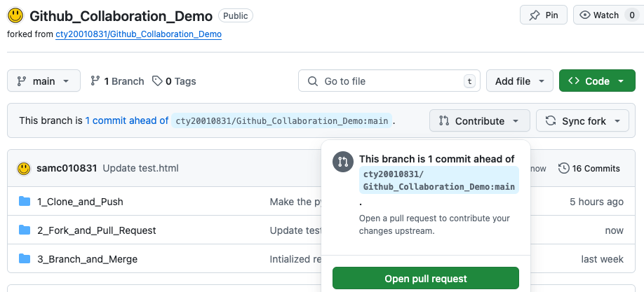
2. Fork and Pull Requests in Action
📒 You can also click “Pull Request” section right next to “Code” section in your forked repo.
A Concrete Example
Commit changes in forked repo
Open pull request
Notes:
Probably include a case when automatic merge becomes challenging.

Slide 21
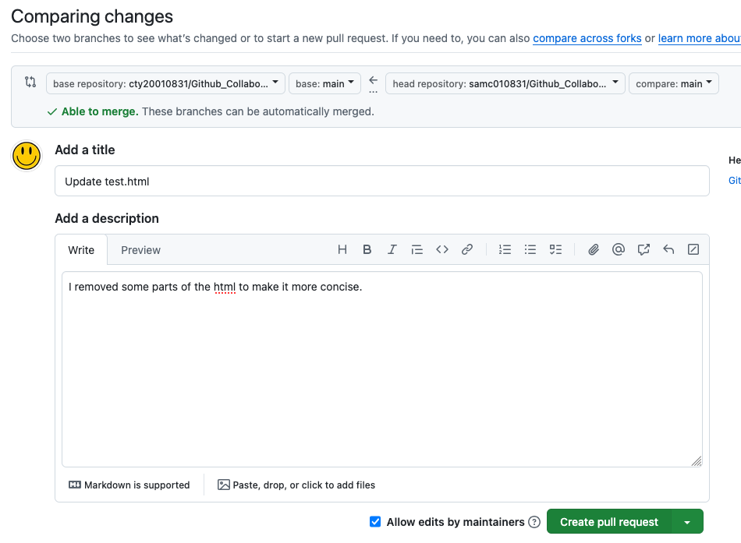
2. Fork and Pull Requests in Action
A Concrete Example (Continued)
Open pull request
Create pull request
Notes:
Probably include a case when automatic merge becomes challenging.

Slide 22
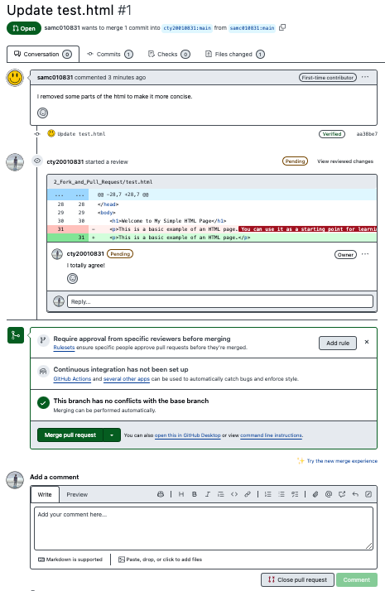
2. Fork and Pull Requests in Action
A Concrete Example (Continued)
🔎
Merge or cancel pull request (for owner of upstream repo)
Notes:
Probably include a case when automatic merge becomes challenging.

Slide 23

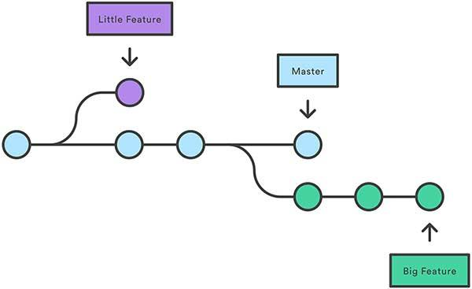
3. Branch and Merge
A branch is an independent line of development, allowing you to work on features without affecting the main branch (e.g., ‘main’ or ‘master’).
Left image source: https://www.shutterstock.com/search/branch-tree
Right image source: https://www.tomasbeuzen.com/post/git-fork-branch-pull/
Notes:
I think I need to explain to them this could be only a high level overview of the power of git branches. Students are welcome to consult additional (online) resources to gain a deeper understanding of the topic. To me, it is better to learn more advanced git and github topics through trials and errors. That said, students are welcome to bring any questions related to branches to the office hour or Ed Discussion forum.

Slide 24
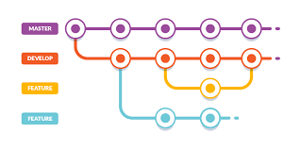
3. Branch and Merge - Why Branching
✅ Isolate Features & Bug Fixes – Work on a new feature without affecting the stable version.
E.g., A team is adding dark mode to an app.
✅ Parallel Development – Multiple team members can work on different features simultaneously.
E.g., A critical bug is found while new features are in progress. => Fix the bug on a separate branch and then merge it back into main.
✅ Safe Experimentation – Test new ideas without breaking the main branch.
E.g., You want to test an AI-powered recommendation system.
✅ Organized Workflow – Keep code history clean and structured.
Image source: https://www.sitepoint.com/use-git-branches-buddy/

Slide 25
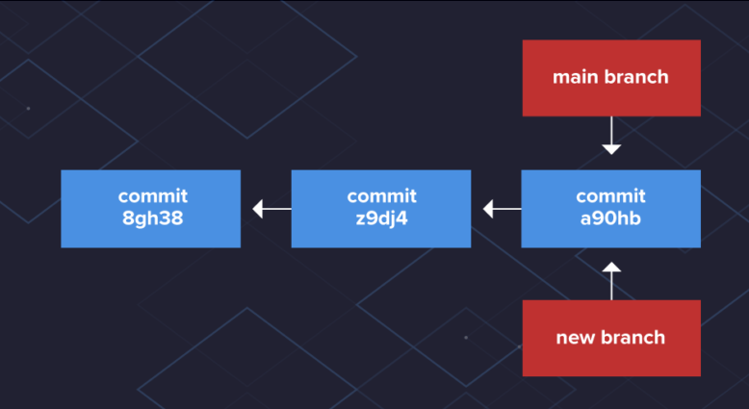
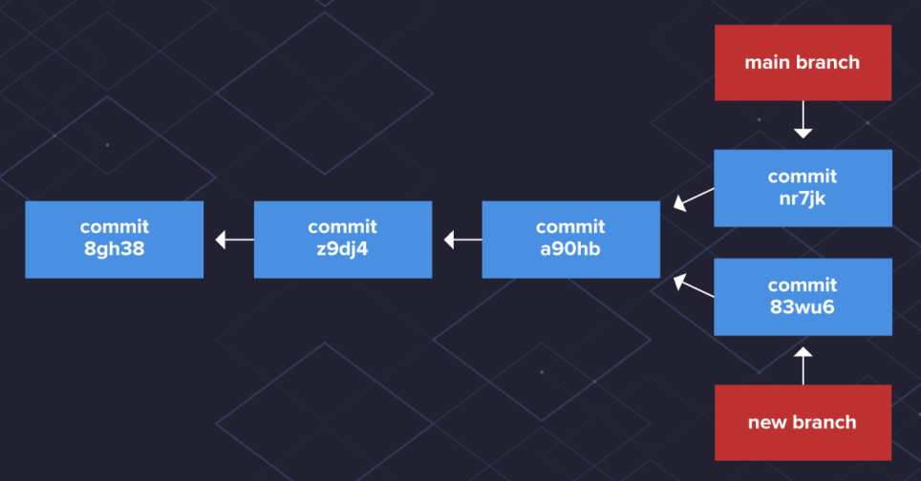
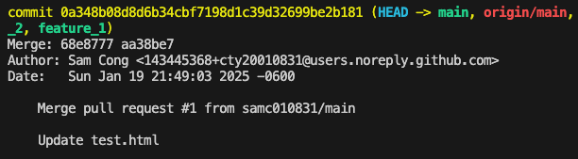
3. Branch and Merge - Under the Hood of Branch
The main branch itself doesn’t have any special properties—it’s simply the first branch created when you initialize a Git repository with git init.
Each time you make a commit, Git assigns it a unique SHA-1 hash to identify that snapshot of files. When a new branch is created, it initially points to the same commit as the main branch. At this stage, both branches share the exact same code state.
As new commits are made in the new branch, Git updates its pointer to track those changes, causing the branch to move ahead of main. Over time, as commits continue on different branches, each branch maintains its own version of the project history.
Reference: https://www.varonis.com/blog/git-branching#merging
Notes:
I think I need to explain to them this could be only a high level overview of the power of git branches. Students are welcome to consult additional (online) resources to gain a deeper understanding of the topic. To me, it is better to learn more advanced git and github topics through trials and errors. That said, students are welcome to bring any questions related to branches to the office hour or Ed Discussion forum.

Slide 26
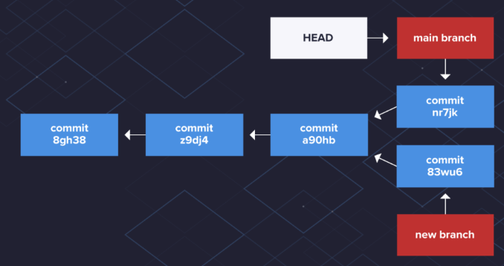
3. Branch and Merge - Under the Hood of Branch
It is important to know which branch you are in (especially on your local computer).
Git knows which branch you have checked out by using a special pointer called HEAD.
When you create a new branch, Git doesn’t immediately change the HEAD pointer to the new branch => There is a dedicated command of git checkout
Reference: https://www.varonis.com/blog/git-branching#merging
Notes:
I think I need to explain to them this could be only a high level overview of the power of git branches. Students are welcome to consult additional (online) resources to gain a deeper understanding of the topic. To me, it is better to learn more advanced git and github topics through trials and errors. That said, students are welcome to bring any questions related to branches to the office hour or Ed Discussion forum.

Slide 27

3. Branch and Merge - Merging Branches
Branch
Branch & Merge
Oftentimes, once we have completed work on your branch, we need to merge it into the main branch. Merging takes your branch changes and implements them into the main branch.
Left image source: https://www.tomasbeuzen.com/post/git-fork-branch-pull/
Right image source: https://www.nobledesktop.com/learn/git/git-branches
Notes:
Spoiler alert: In this lab, we will only cover `git merge`. I will allude to `git rebase` as more advanced topics later.

Slide 28
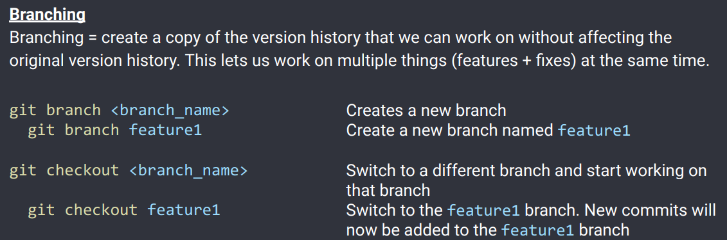
3. Branch and Merge - Often Used Commands
Reference: https://supersimpledev.github.io/references/git-github-reference.pdf

Slide 29
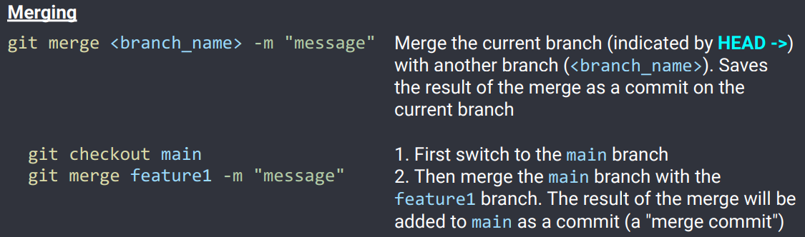
3. Branch and Merge - Often Used Commands
Reference: https://supersimpledev.github.io/references/git-github-reference.pdf

Slide 30
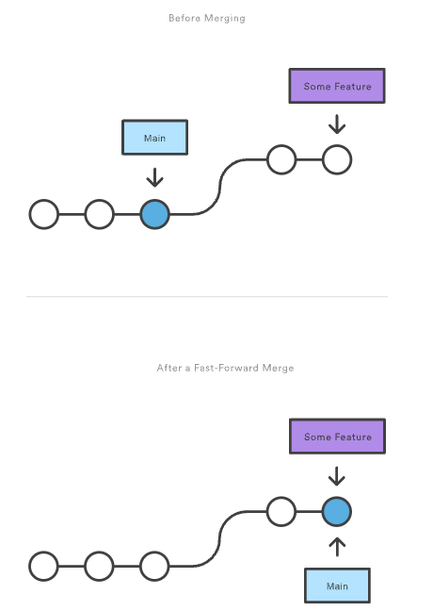
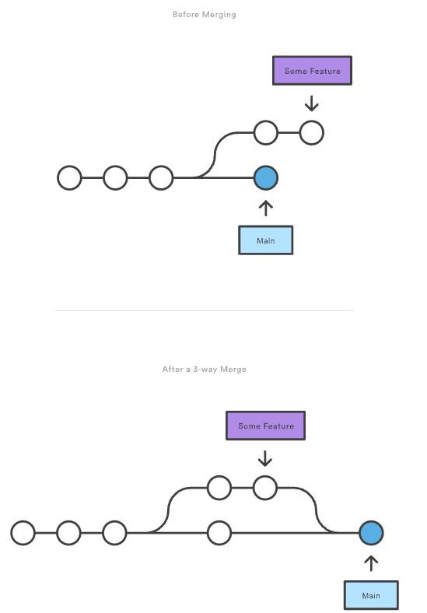
3. Branch and Merge - Ways of Merge
Fast-Forward Merge
3-way Merge
A fast-forward merge happens when the current branch has a direct linear path to the target branch.
Instead of creating a merge commit, Git simply moves the branch pointer forward to match the target branch, effectively integrating all its commits into the current branch.
A fast-forward merge isn’t possible if the branches have diverged.
Without a direct linear path to the target branch, Git must use a 3-way merge, which creates a dedicated merge commit to unify the histories.
This process is called a 3-way merge because Git references three commits: the latest commit from each branch and their shared ancestor.
Reference: https://www.atlassian.com/git/tutorials/using-branches/git-merge

Slide 31
3. Branch and Merge - Ways of Merge
By default, Git performs a fast-forward merge if there’s a direct path from the current branch to the target branch.
No new merge commit is created—Git simply moves the branch pointer forward.
✅ Example of an automatic fast-forward merge
git checkout main
git merge feature-branch
🔹 We can prevent it (i.e., have a merge commit) even when a fast-forward is possible.
git merge --no-ff feature-branch

Slide 32
3. Branch and Merge - Ways of Merge
If branches have diverged (i.e., they contain different commits), Git automatically performs a 3-way merge.
Git compares the latest commit from both branches and their common ancestor to create a merge commit.
If you prefer a linear history (without merge commits), you can use git rebase to prevent 3-way merge (we will not cover rebase in this tutorial but I have included resources to learn this topic).

Slide 33
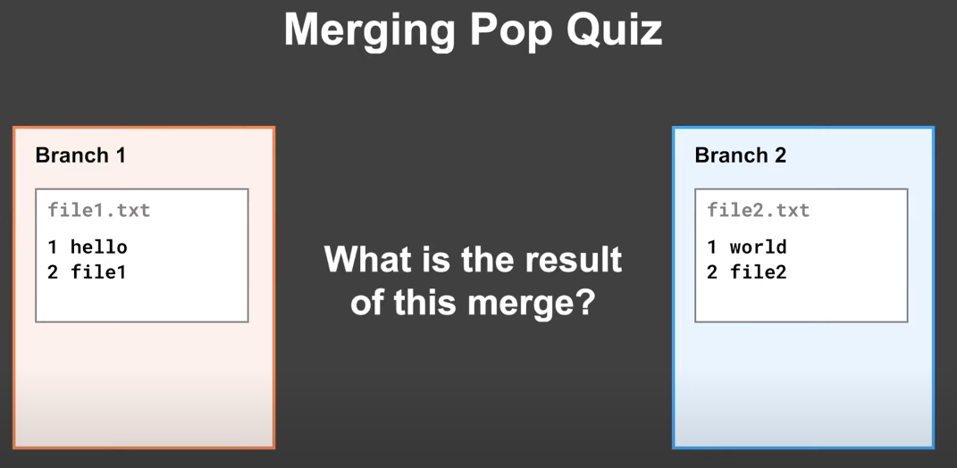
3. Branch and Merge - Merge Conflicts
Reference: https://www.youtube.com/watch?v=Q1kHG842HoI&t=49s

Slide 34
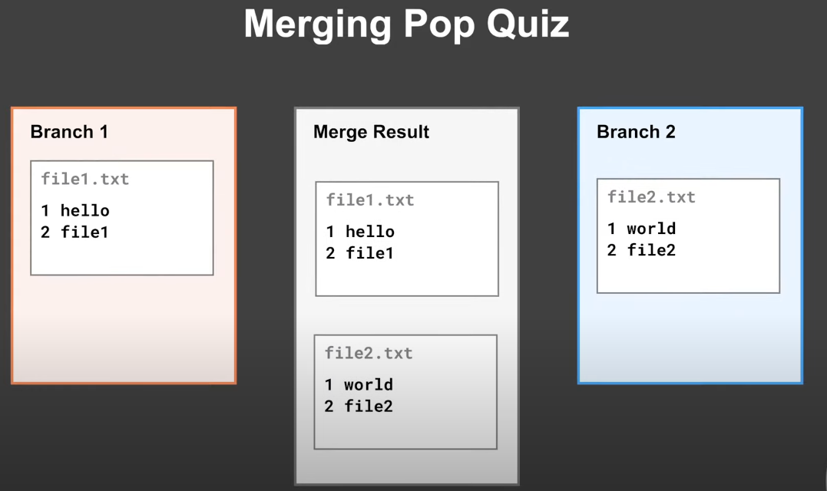
3. Branch and Merge - Merge Conflicts
Reference: https://www.youtube.com/watch?v=Q1kHG842HoI&t=49s

Slide 35
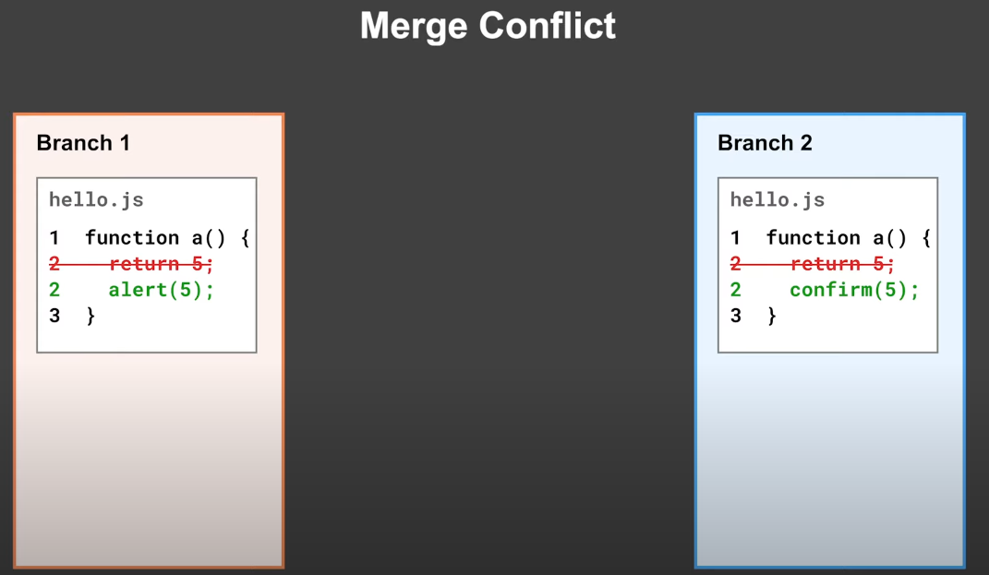
3. Branch and Merge - Merge Conflicts
Reference: https://www.youtube.com/watch?v=Q1kHG842HoI&t=49s

Slide 36
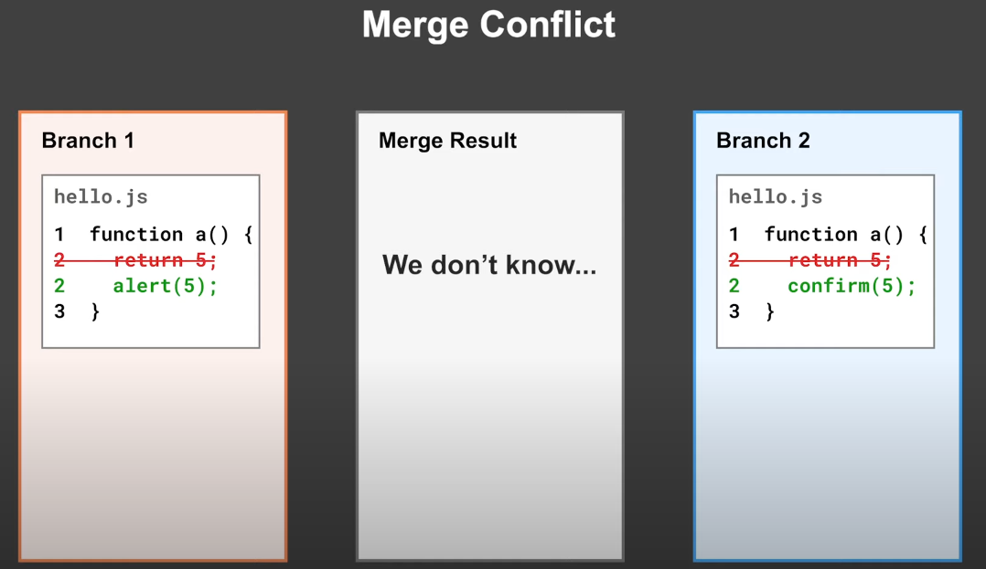
3. Branch and Merge - Merge Conflicts
Reference: https://www.youtube.com/watch?v=Q1kHG842HoI&t=49s
Notes:
We need to solve the merge conflicts by ourselves.

Slide 37
Simple Demo

Slide 38
More Advanced Topics
Git reset vs revert
Merge, rebase, and dynamic rebase
Fast-Forward Merge and Three-Way Merge
Git stash
(Different) Git workflows

Slide 39
Final Tips
Internet is your encyclopedia.
Practice (debugging) makes perfect.
Pick your own learning approach.

